Slide 1
Wait! There is more … What about Privacy ?
Due to privacy concerns, you will not see all the identifying information in the table, but you should have sufficient information to make decisions.
The upcoming pages will give you an understanding of how the data is disclosed on a need-to-know basis.

Slide 2

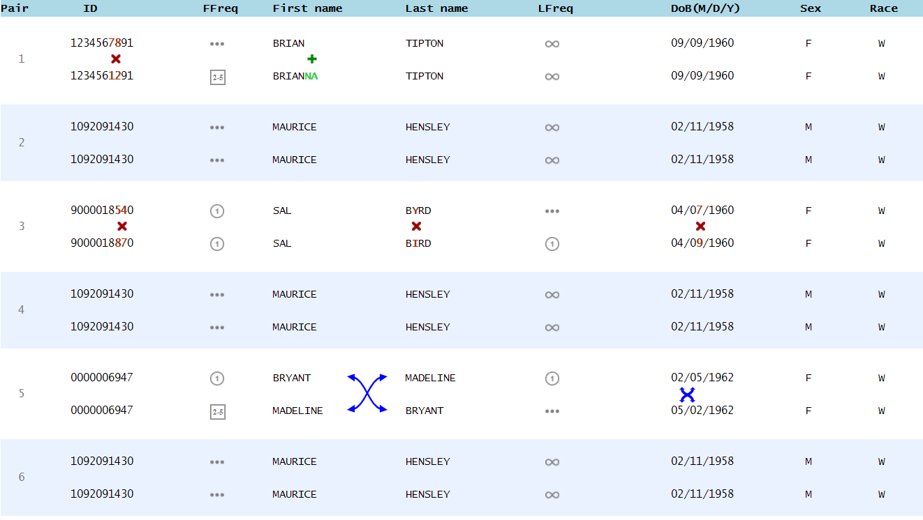
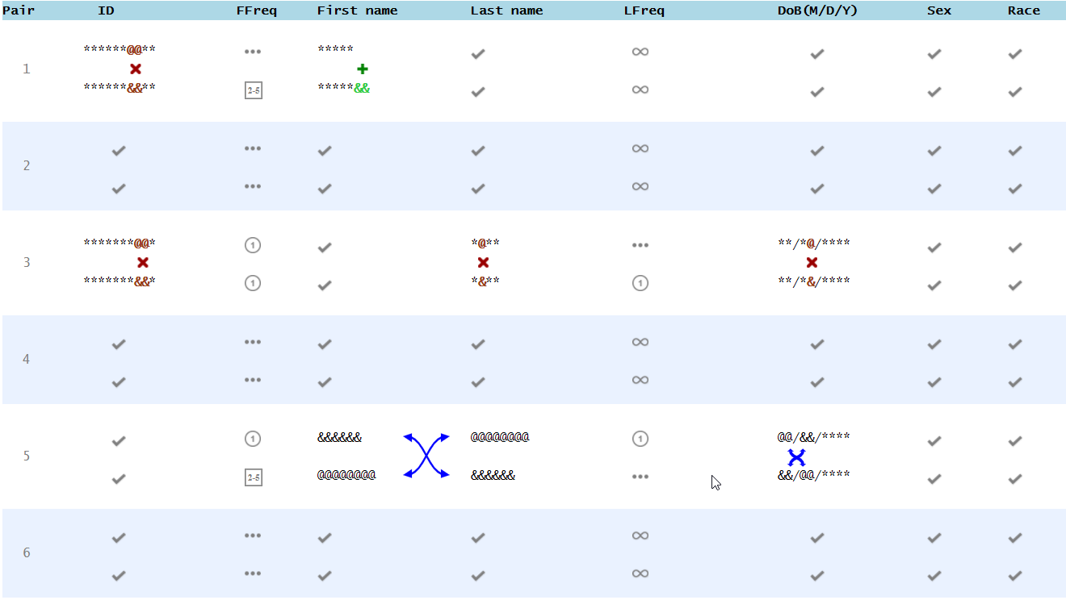
Checkmarks: Identical Values
Identical values are shown as checkmarks.

Slide 3
Stars Used in Similar IDs
When two items are similar, stars (they look like this ***) are used for characters that are the same.
@@@ and &&& show the characters that are different.

Slide 4
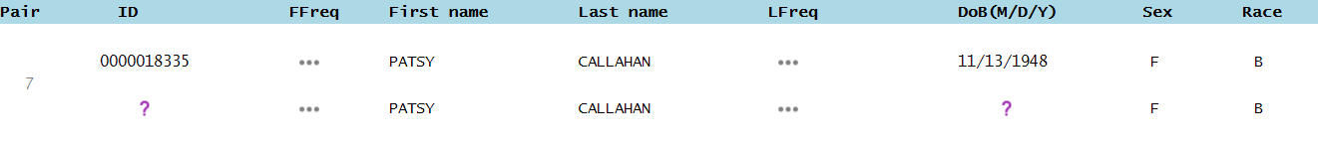
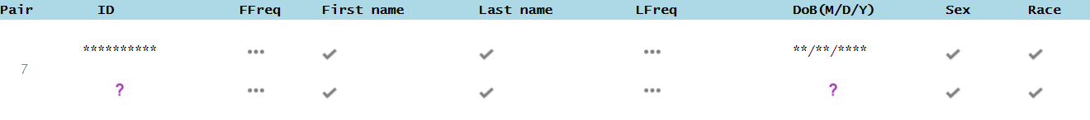
*** When the Matched Value is Missing ()
When one of the values in a pair is missing, the other value is not useful.
Thus, the matched value with missing is represented by ***

Slide 5

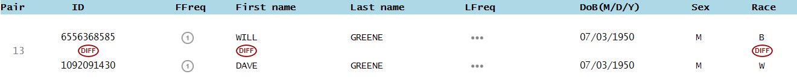
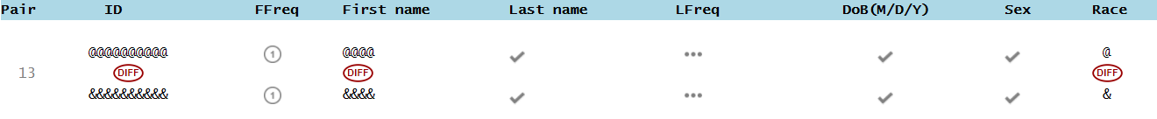
Different Items
When two items are very different, they are shown as @@@ and &&&

Slide 6

Swaps
When columns have swapped values, the swapped parts are shown by &&& and @@@
Notes:
Add date swap to slide (also fix bug)

Slide 7
Understand the Symbols?
Take a moment to look at the next slide carefully and understand what the symbols and icons mean for different values.

Slide 8
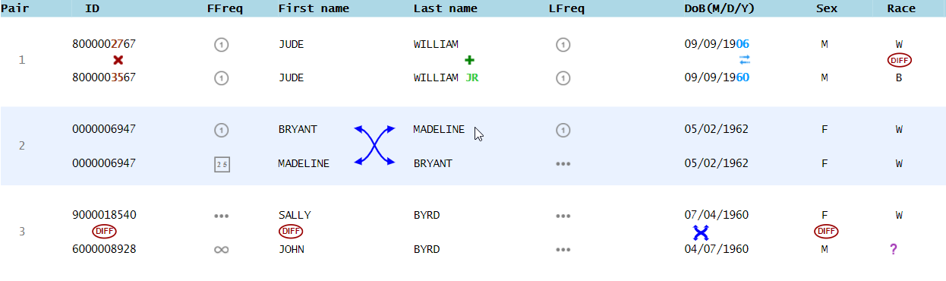
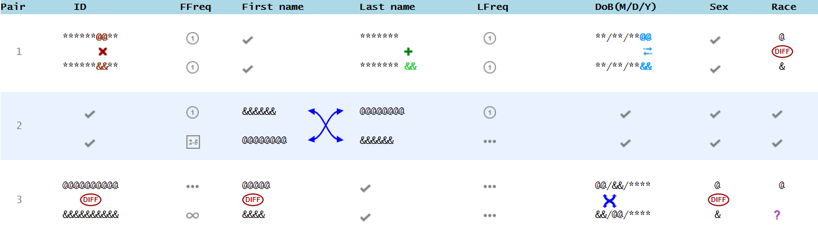
*

Slide 9
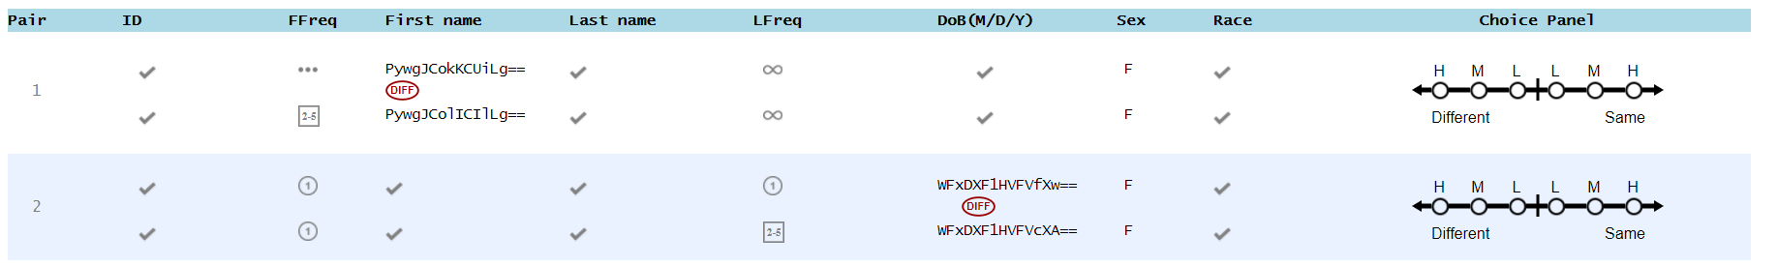
Encryption Mode
Encryption mode only have same/different icon.
When information is identical, a pair of check marks will be displayed.
When information is NOT identical, encrypted information will be displayed.
Notes:
Will show,
* when identical check mark
* when different (slightly or totally): totally different jumbled up
* icons will be used?

Slide 10
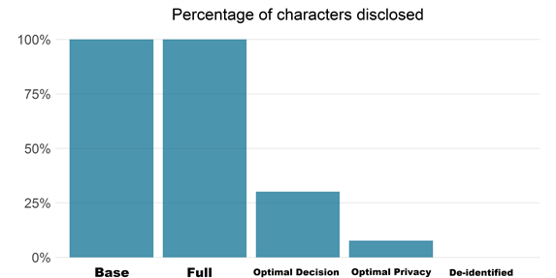
Conclusion
100%
100%
30.14%
7.63%
0%
As you can see, the five modes you just did disclose different percentage of characters.
The percentage of characters disclosed will not only affect privacy risk in each mode, but also your accuracy in record linkage.
The goal of our research is to find the balance between privacy and accuracy in record linkage. Thank you very much for participating this user study.
Notes:
Add date swap to slide (also fix bug)

